Slide 1

Title Slide
Technical Exploration: Western Hospitality Services and Pay It Forward
Prepared by Raymond Wang, April 17th, 2024

Slide 2
Table of Contents
Walkthrough
Project Introduction
System Analysis
Partnering Together

Slide 3
Section I: Project Introduction
Click here to return to the Table of Contents

Slide 4
Food Insecurity at Western
Key statistics
600%
40%
YoY usage increase of the USC Food Bank
From 2022-23 to 2023-24 school years
of Canadian post-secondary students are identified as
Food Insecure
Can we sustain our population growth with
increasing food insecurity at Western?

Slide 5
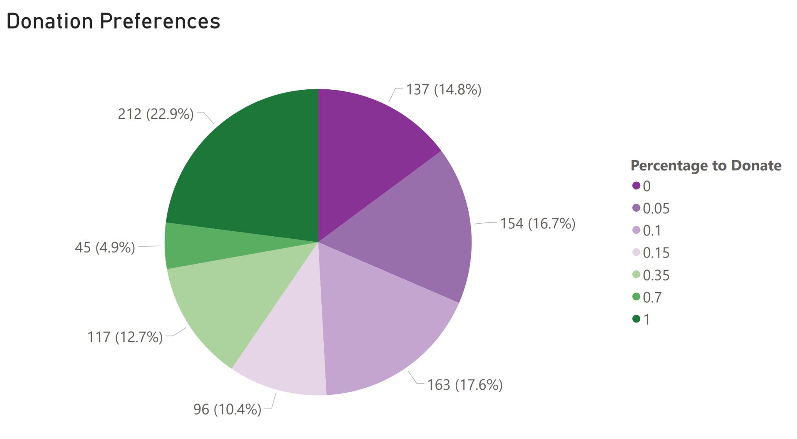
Spring 2024 Student Survey on Meal Plan Donations
Key results (n=942) and projected program impact
31.4% of all first years would opt to Pay it Forward, donating approximately
41% of their end-of-year account balances, averaging
$64.75 per person
With 31.4% of all 7,850 first-years opting-in, 2,467 donors could Pay it Forward for a
$159,720 donation pool or 7,986 meals at $20/meal

Slide 6
Introducing the Pay It Forward Project (PIF)
Students donating meal plan money for urgent, short-term food security support
Question
How can Western harness unused meal credits to combat food insecurity on campus?
Considerations
Convenience: Maximize student contributions by minimizing friction in the donation process—implies familiar platform.
Accessibility: Ensure all students who need PIF can benefit from it, while preserving their privacy and complying with regulation.
Effectiveness: Pair qualitative, all-party feedback (via survey/focus groups) with quantitative usage tracking to gauge impact.
Methodology
Collect
Qualify
Distribute
Integrate with the Meal Plan Top-Up portal to collect donations, store funds, and issue tax receipts.
Collaborate with Western EDI, and the Registrar/Financial Aid Office to equitably qualify food aid recipients.
Allocate and distribute pooled funds to recipients’ meal plan accounts, with discreet access by ONECard.
End Result
By the end of Fall/Winter 2024–2025, PIF combats on-campus food insecurity by equitably enabling the donation of thousands of meals directly to students in need.

Slide 7
Section II: System Analysis
Click here to return to the Table of Contents

Slide 8
Stakeholder Groups
Roles, goals, and actions
Donors (Students with Meal Plan Funds)
Role: Contribute to the resource pool for distribution.
Goal: Easily donate extra credits to peers in need.
Actions:
Verify remaining balance on meal plan account.
Decide on what amount of funds to donate.
Opt-in to the Pay It Forward program.
Validate that funds were contributed.
Policy Administrators (Financial Aid Office)
Role: Manage logistics of donation and qualification.
Goal: Fairly allocate resources to recipients.
Actions:
Finalize criteria for determining program eligibility.
Identify list of eligible food-insecure recipients.
Allocate funds to recipients.
Validate that funds were allocated appropriately.
Recipients (Food Insecure Students)
Role: Access resources to alleviate food crises.
Goal: Utilize donated credits to secure nutrition.
Actions:
Request food security assistance via FAO (PIF).
Receive meal plan funds for use in eateries.
Consume healthy, affordable meals on campus.
Validate that funds are meeting emergency needs.
Food & IT Service Providers (Hospitality)
Role: Enable distribution and redemption of credits.
Goal: Reliably offer healthy food and IT systems.
Actions:
Implement and maintain PIF IT systems.
Execute fund distribution demands from the FAO.
Partner with other initiatives to drive food security.
Validate that funds were correctly distributed.

Slide 9
System Components
Current state and target state features required to implement Pay It Forward
Hospitality Services Front-End
Meal Plan Top-up Site (mealplan.uwo.ca)
ONECard with Point-of-Sale Terminal
myHousing portal (first-years only / refund)
Campus Meal Plan Office (upper-years / refund)
Current State:
Reload card with flex dollars.
Check balance.
Pay for meals.
Request refund of meal plan flex dollars. (April 1–30, fee of $40)
Need to implement:
Opt-in to donate to Pay It Forward (yes/no, %/$).
Inform stakeholders of program impact (public dashboard—Power BI, joint report, etc.)
Financial Aid Office Operations
Student Services Site (studentservices.uwo.ca),
Internal Administrative Systems (to investigate)
Current State:
Determine need-based aid with student financials.
Need to implement:
Define which students qualify for PIF (underway).
Hospitality Services Back-End
Meal Plan Administrative Systems (to investigate)
Current State:
Enable present end-to-end meal plan functionality.
Need to implement:
Track donation preferences and share with FAO.
Redistribute funds based on FAO calcs/criteria.

Slide 10
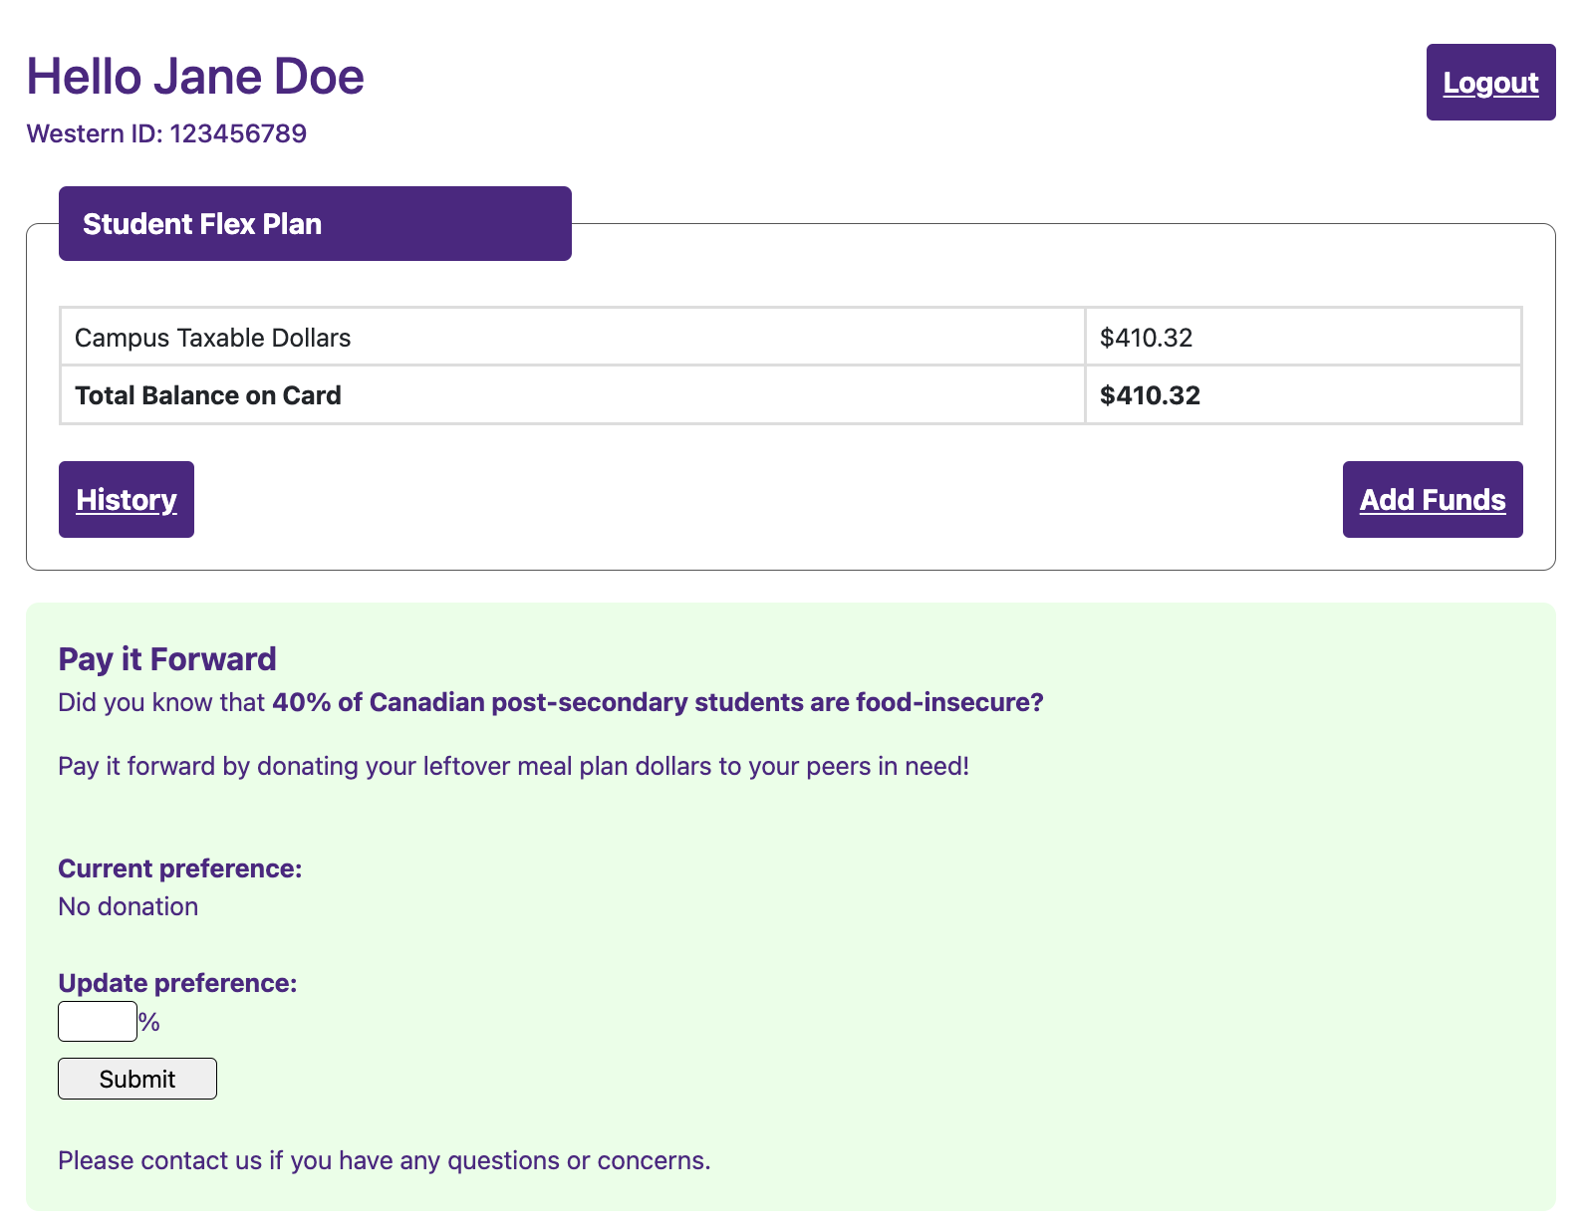
Donation Page Example Wireframe
Direct integration with meal plan top-up website for convenient access

Slide 11
Section III: Partnering Together
Click here to return to the Table of Contents

Slide 12



Overview: Paths Forward
How could we technologically implement the Pay It Forward program together?
Full Integration: People, Process, Technology
Partial Integration: People and Process
Standalone Effort: Process only
People: The PIF student team and Hospitality collaboratively develop and deploy the system
Process: Users access forms / funds directly from Hospitality
Technology: Hospitality’s IT resources directly operate Pay It Forward’s opt-in form, preference collection database, and distribution systems
People: The PIF student team primarily develops a parallel system for Hospitality use
Process: Hospitality sends users to PIF platform for opt-in
Technology: Pay It Forward’s team maintains separate technical infrastructure for opt-in and preference collection, with Hospitality moving plan funds
People: The PIF student team and Hospitality do not build any interfacing IT systems
Process: Hospitality assists with raising awareness for PIF
Technology: PIF operates like a traditional fundraiser, with students pooling external funds (e.g., refunded meal plan money) for donation to students in need
…and more! This is by no means an exhaustive list.

Slide 13
Example Technical Solution Architecture
What components fit into the Pay It Forward and Ancillary Systems?

Slide 14
Evaluation of Effectiveness vs. Complexity
What key considerations are needed
Trade-off Matrix
1
Full Integration: People, Process, Technology
High effectiveness: minimizes friction in donation/distribution
High complexity: significant shared development work
1
2
Partial Integration: People and Process
Medium effectiveness: more friction reduces donations
High complexity: similar but separate development effort
Effectiveness
2
3
Standalone Effort: Process only
Low effectiveness: maximum friction, low engagement
Low complexity: simple fundraiser effort
3
Complexity of Implementation

Slide 15


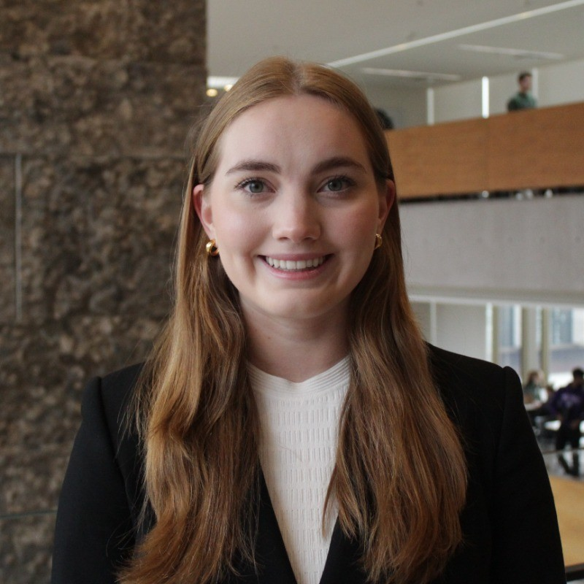
Meet the Pay it Forward Team
ABOUT US
Raymond Wang
Technology Lead
Ivey HBA and Computer Science Technology
LinkedIn
E: rwang.hba2025@ivey.ca
Saanvi Kapoor
Founder & Project Lead
Ivey HBA
Finance LinkedIn
E: skapoor.hba2025@ivey.ca
Hannah Mahr
Operations Lead
Ivey HBA
Consulting
LinkedIn
E: hmahr.hba2025@ivey.ca

Slide 16
Title Slide
Thank you!
Questions, next steps?

Slide 17
Section IV: Technology Exhibits
Click here to return to the Table of Contents

Slide 18
Section III: Technical Components and Integrations
Click here to return to the Table of Contents

Slide 19
Section IV: Key Performance Indicators
Click here to return to the Table of Contents

Slide 20
Defining the Problem
Primary assumptions guiding my analysis
Feasibility
Stores
Induced Demand
Competitors maintain their expansion rate without rapidly growing at Starbucks’ rate
Demographic information regarding the United States remains constant
Starbucks will continue its operations for the foreseeable future despite the new stores
Kiosks, malls, brick and mortars will not be differentiated, we will consider a holistic Starbucks store
Difficult because of the inability to find the volume / size of each individual store, however, it will impact the feasibility of aggressive expansion
Starbuck’s strong brand loyalty and ability to draw in new customers assumes demand is maximized as a function of demographic information
Demand increase on similar competitor products will not be considered, though it might be a factor to consider
“Feasibly open” - Assume present day conditions do not change (competitors do not aggressively expand with you, demographic information is constant, going concern principle)
“Maximum Starbucks Stores” – not going to differentiate between different types of stores, kiosk vs mall vs simple brick and mortar, impossible to aggregate that kind of data
Ideally a third assumption in defining the problem

Slide 21
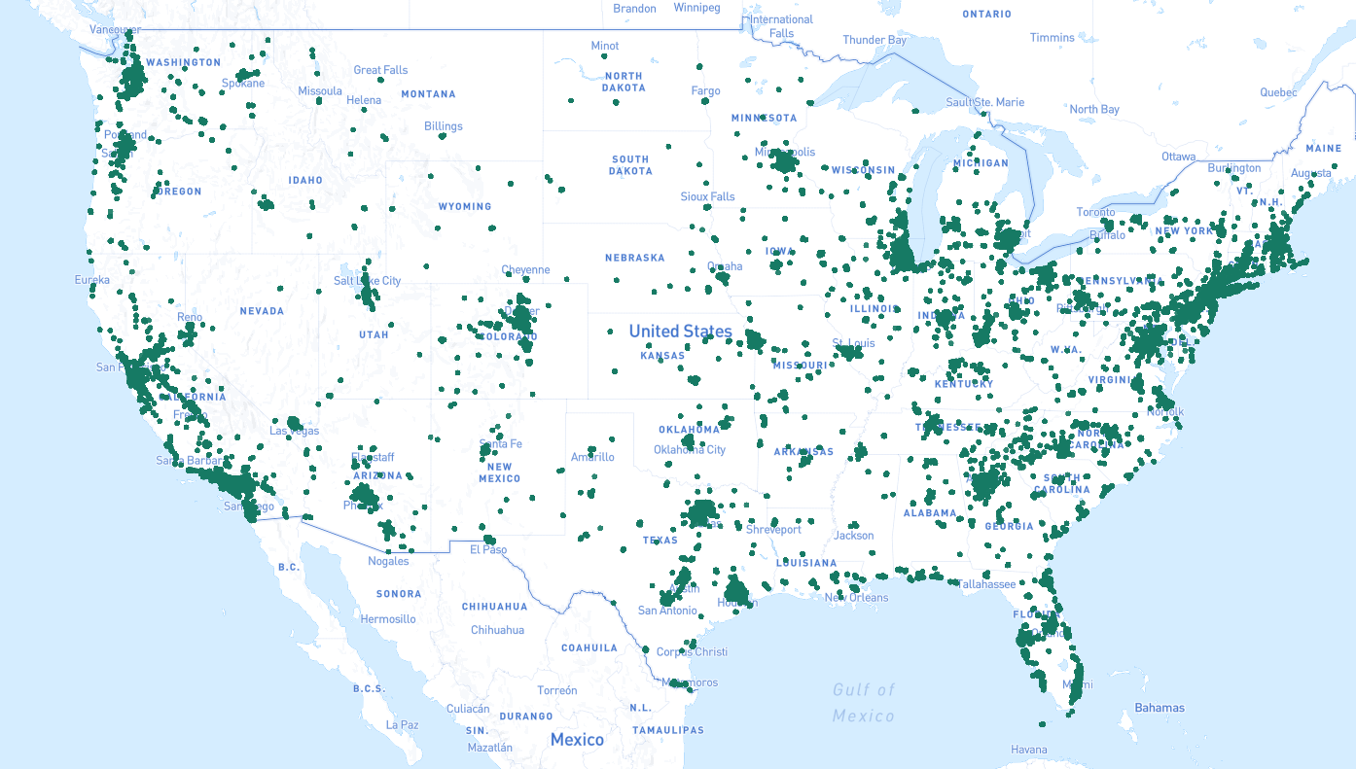
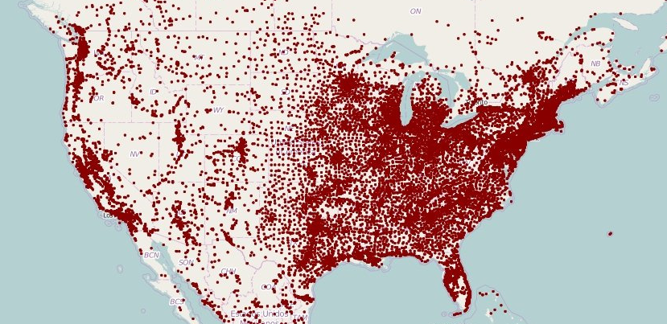
Descriptive Analytics of Case Dataset
Starbucks partially mirrors population distribution in the US
Starbucks and Population Density
The distribution of Starbucks locations appears to correlate with the population distribution of the US
While Starbucks matches US population distribution, it is less concentrated in Midwest and Western states
Starbucks Locations - 2018
Population density likely encapsulates many factors Starbucks uses to choose store locations, such as demand
What factors influence population density?
What does Starbucks consider when
choosing a new location?
North American Population Density - 2018
Each dot represents a city of 1000+ people

Slide 22





Starbucks History
Hypotheses: Market Research
Starbucks cares most about specific characteristics for new store locations
Key Characteristics
Feasibility
Starbucks has recently had to close many stores due to cannibalization, leading them towards a data-driven store opening approach (2008).
Neighbourhood income
Neighbourhood income, age, gender, and other social data is relatively easy to obtain due to the strength of the
American census.
Age
Landmarks
Selecting sites for new stores is still more of an art than a science, requiring boots on the ground with understanding of
local markets (2008).
Proximity to businesses and average foot traffic are more difficult to account for due to the specificity of these factors per location – two strip malls in the same county could be
very different.
Traffic
Proximity to businesses and parking lots

Slide 23














Hypothesis: Data Availability
Data provided by the United States Census Bureau
Avg. Household Value
“Frappuccino Effect” increasing local household value
Avg. Median Age
McDonald’s, Dunkin’s, Starbucks
Implied younger age demographic
Competitors could indicate lucrative areas to expand to
Avg. Sex Ratio
Sum Area
Implied 65-35 female gender preference
Larger areas could be correlated with more stores due to more area to build upon
Sum Undergrads
Avg. Density
Young professionals tend to prefer Starbucks drinks
Dense areas have high traffic and draws based on spheres of influence
Sum Workers
Sum Population
Prioritization of locations
near working offices
More people imply a stronger pull to build nearby
Sum Non-WFH Workers
GDP
WFH employees may prefer the “Third-Place” work concept
Strong economic activity could imply a lucrative opportunity
Sum Commute Vehicles
Increased congestion could lead to more location desirability

Slide 24




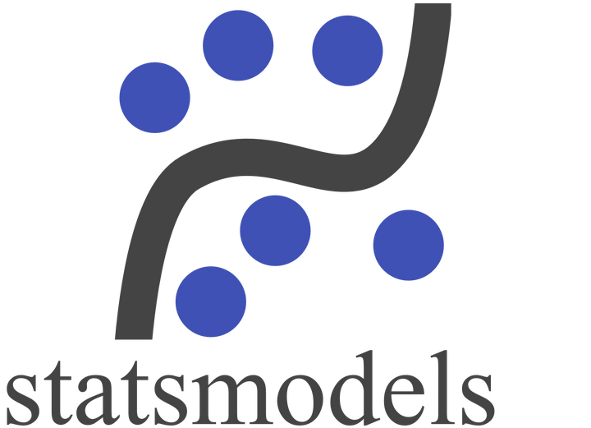


Data Analysis Approach
8C approach: compile, clean, combine, calculate, correlate, compute, confirm, chart
CSV flat files
Compile common case, census, and closure data
Python (pandas)
Clean raw datasets to improve data quality
PostgreSQL
Combine into views using joins and filter conditions
PostgreSQL
Calculate store count, GDP for zip/city census tracts
Power BI
Chart new recommended stores geographically
statsmodels
Confirm model validity with testing/training datasets
scikit-learn
Compute linear regression for store count to regions
Microsoft Excel
Correlate relationships between input variables

Slide 25
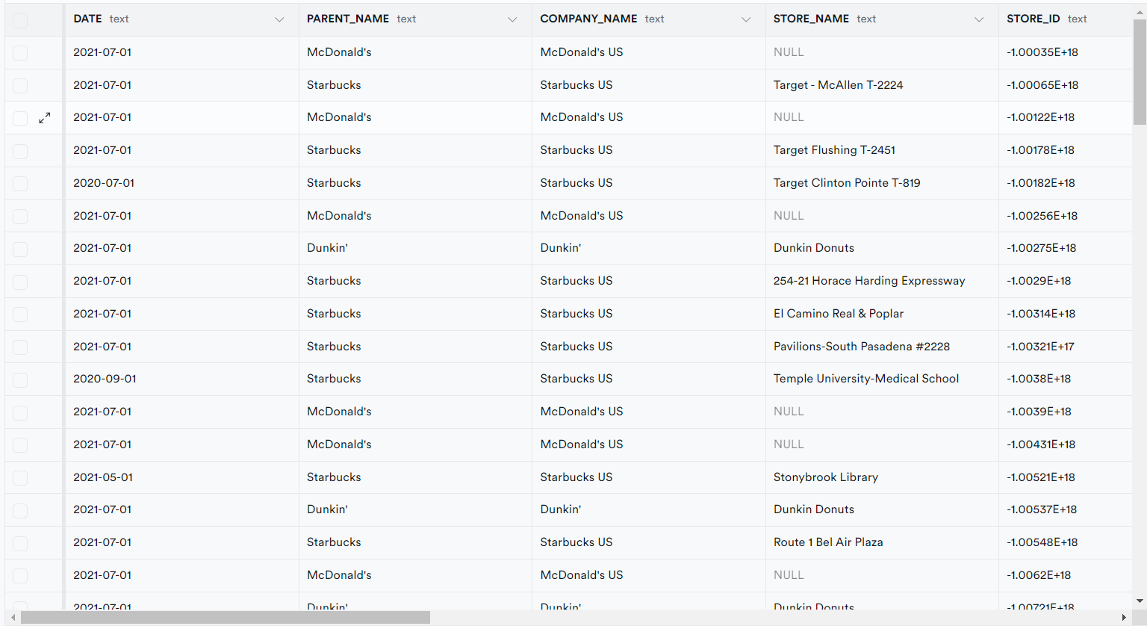
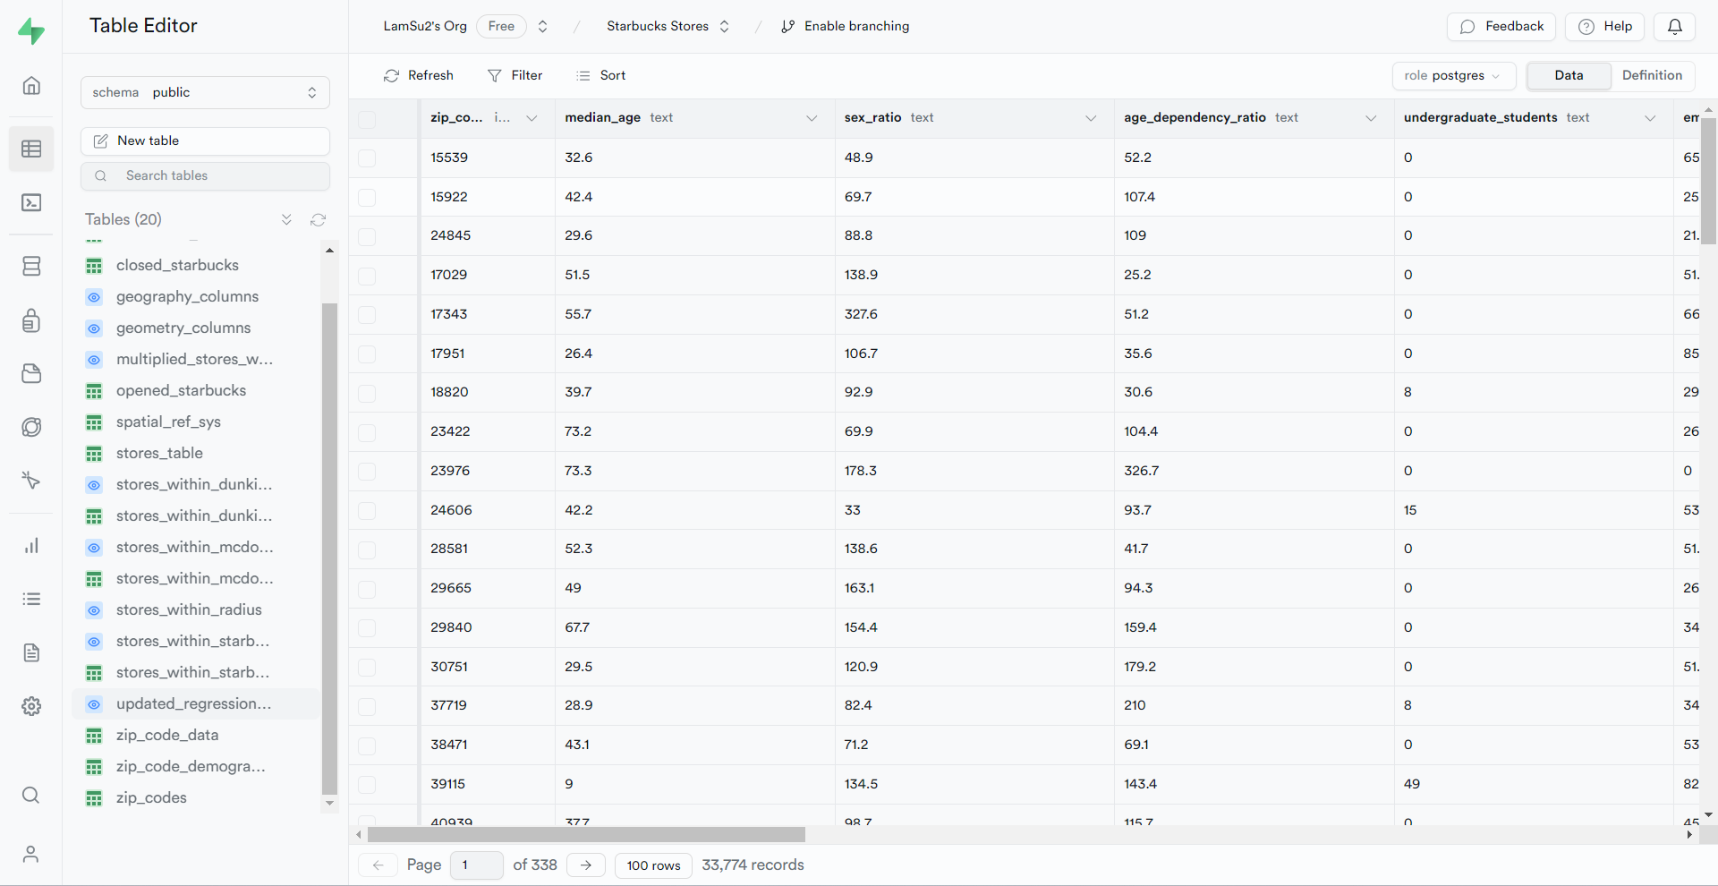
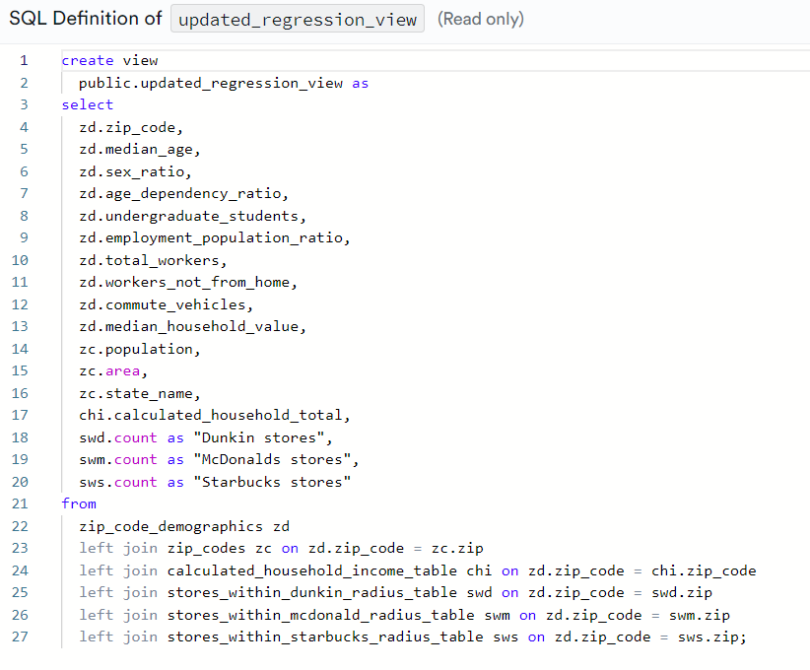
Supabase
PostgreSQL Database for transforming and viewing tables
Cleaned With Pandas and Inputted
Into Supabase
Combined CSVs to Create Views
With Supabase

Slide 26
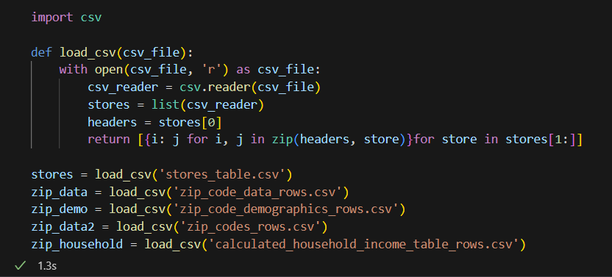
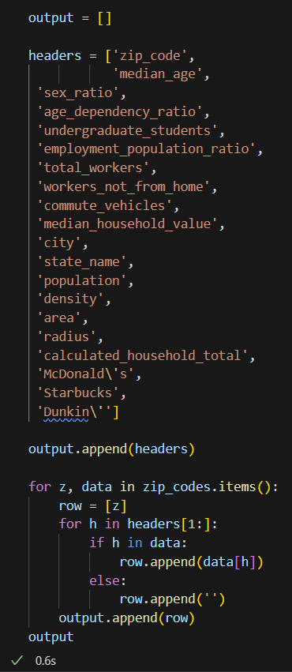
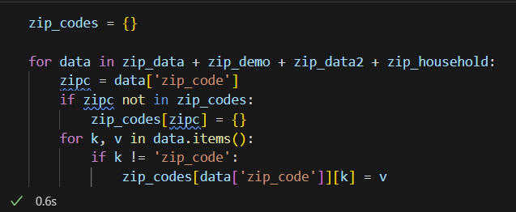
Python Implementation
Data preparation and pre-processing steps
Loading the data from all the previously defined tables in Supabase using csv readers
Appending all relevant information to the “output” list, which will then be written to a csv
Creating a dictionary with zip code as the key for all data for that zip code

Slide 27

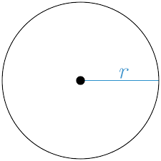


Important Calculations
High-level approach
Independent Variables
Need to calculate the number of stores for McDonald’s, Dunkin’, and Starbucks for a given municipality
Assume each zip code is shaped like a circle, use area to back-calculate radius
Search for coffee shops in database with the same state
Dependent Variables
Need to calculate the total GDP for any given municipality to measure economic output as part of our hypothesis
Sum the product of household income to number of households
Sum the product of family income to number of families if
household missing

Slide 28
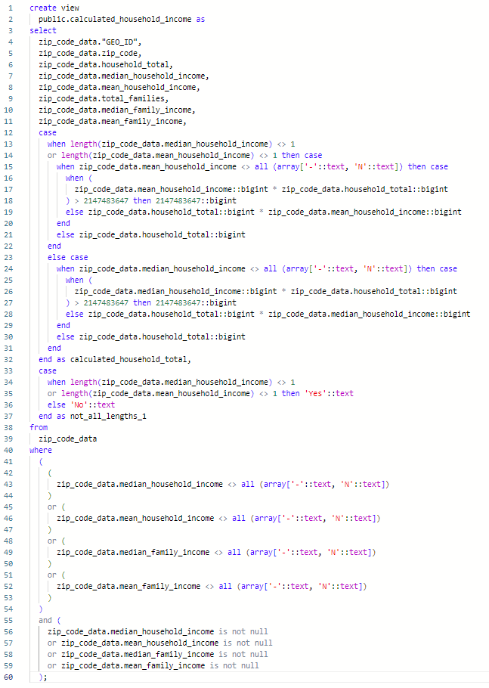
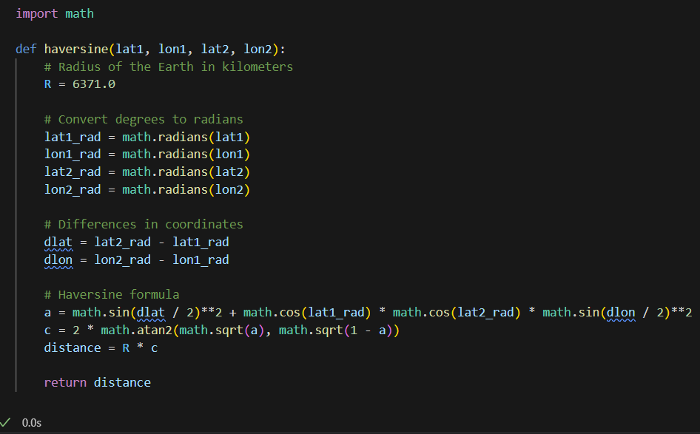
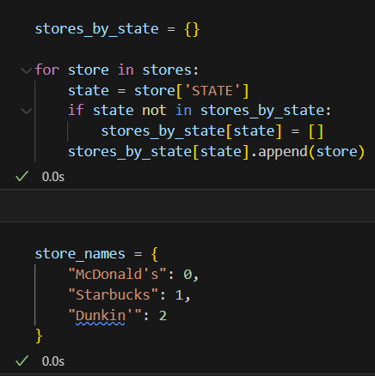
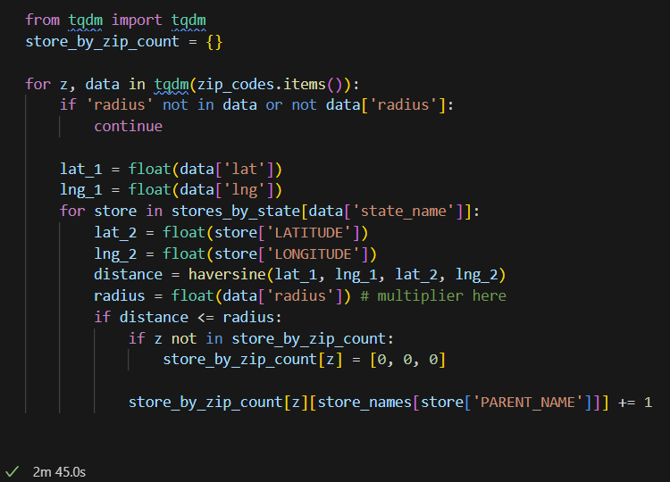
Important Calculations
Implementation
Stores in Radius
GDP

Slide 29
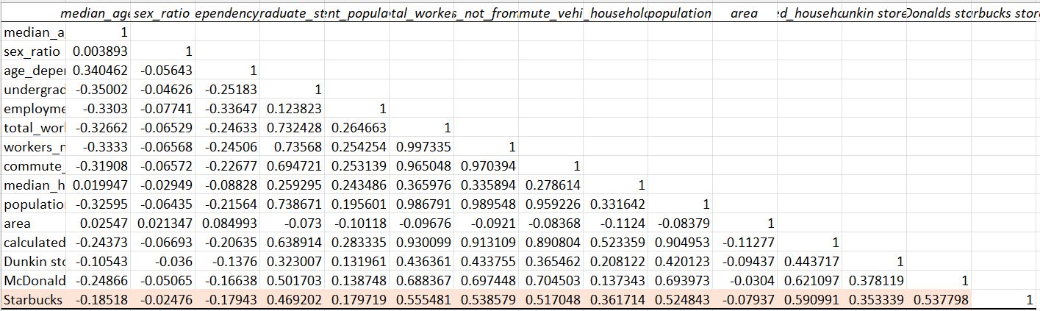
Zip Code: Descriptive Analytics
Granularity challenges and data insights
Data shows no clear relationship between any independent variable and total Starbucks stores.
Zip code data is far too granular to demonstrate any clear relationship.

Slide 30
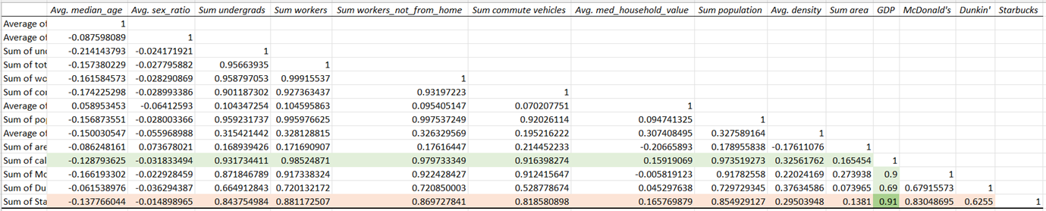
City: Descriptive Analytics
Correlation analysis and demographic influences
Data appears to be much more linear in relation to demographic data, grouped much tighter together. The correlation matrix demonstrates strong fit with Starbucks stores.

Slide 31
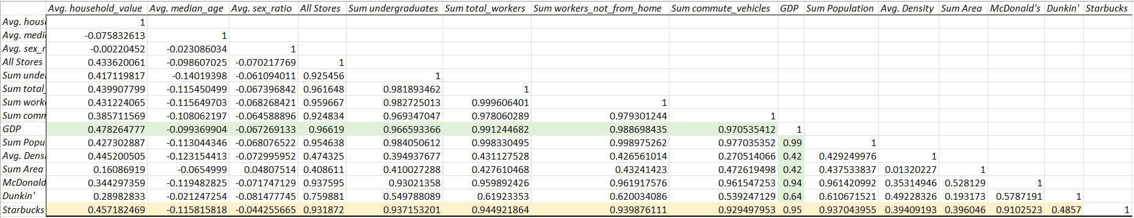
County: Descriptive Analytics
Correlation analysis and demographic influences
Data appears to follow a mostly linear relationship with most input parameters, correlation matrix shows strong correlation between demographic data and number of Starbucks stores

Slide 32


Area Types
Aggregating at the city level was the most effective for time and relevance
Area Level
Pros
Cons
1
Zip Code
Large amounts of data available, strong qualitative fit with Starbuck’s local impact
Data is far too varied and granular to demonstrate meaningful relationships
41,683 ZIP codes
in the U.S.
2
City
Perfect middle-ground between the two alternatives, has sufficient data points with less generalization
Not all incorporated townships in the US provide the same level of economic data
19,495 incorporated cities
in the U.S.
3
County
Can provide more comprehensive picture of economic factors, strongest quantitative fit with data
Overly reduces number of data points and averages data across differing regions
3,143 counties
in the U.S.
Disclaimer: Some data points missing from US census, assumed to be rural area with less data-collection infrastructure

Slide 33

City Correlation Matrix: Selecting Independent Variables
GDP is the strongest independent variable
After running a correlation matrix with a variety of variables, I found that GDP had the best overall correlation with Starbucks stores as well as its competitors and the other variables that I thought might be related to store numbers – they were colinear.

Slide 34
Polynomic Behaviour: Transforming Age and Gender
Transforming the necessary variables
Age is normally distributed relative to stores,
it must be transformed into a polynomial
before linear regression
Similar to age, the gender ratio must be
altered to produce the best results

Slide 35
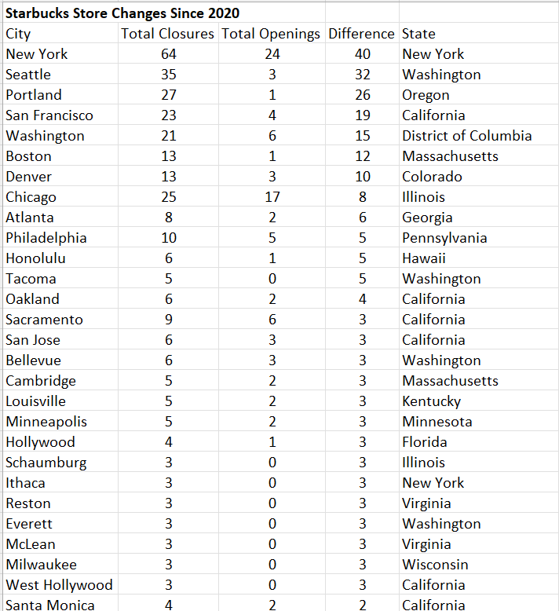
Finding Saturated Markets
Large cities like New York, Seattle, and Portland had many more closures than openings
Saturated Starbucks Markets
The most populated cities (New York, Seattle, Portland) had more closures than openings since the pandemic
Most of the cities with more closures than openings were in populated, largely white-collar areas
(California, Washington, Massachusetts)
Assumption: Markets where the pandemic forced closures were likely saturated pre-pandemic
Differential between store closures and openings

Slide 36
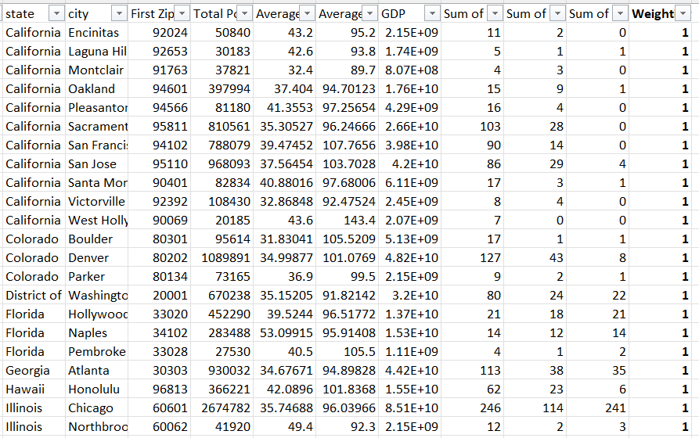
Filtering for Saturated Markets: Discussion on Weights
Weighting strategies for market analysis
Insufficient amount of data when accounting for only saturated cities
Including same-state stores at a weight of 0.1 allows for sufficient supply
of training data
Although a generalization, assumption is that cities in the same state share some similar characteristics
Weights allow for effective prioritization of training data to predict
optimal store count

Slide 37
Linear Regression
Rational for model selection
Linear Regression
Machine Learning Model
Simplicity
Interpretability
Assumption quantity
Complexity handling
Generalization
Highest potential
Linear regressions preserve linear relationships between independent & dependent variables while maintaining simplicity
Notes:
Pro: ML try it’s best to create an equation that hits all data points, HOWEVER the points are scattered especially at low GDP figures & when the model is forced to choose between 0 & 1. Focus more on filtering data for good data points rather than indexing on the model. Linear regression preserves the simplicity while preserving the linear relationships we observed between input parameters and dependent variables.

Slide 38
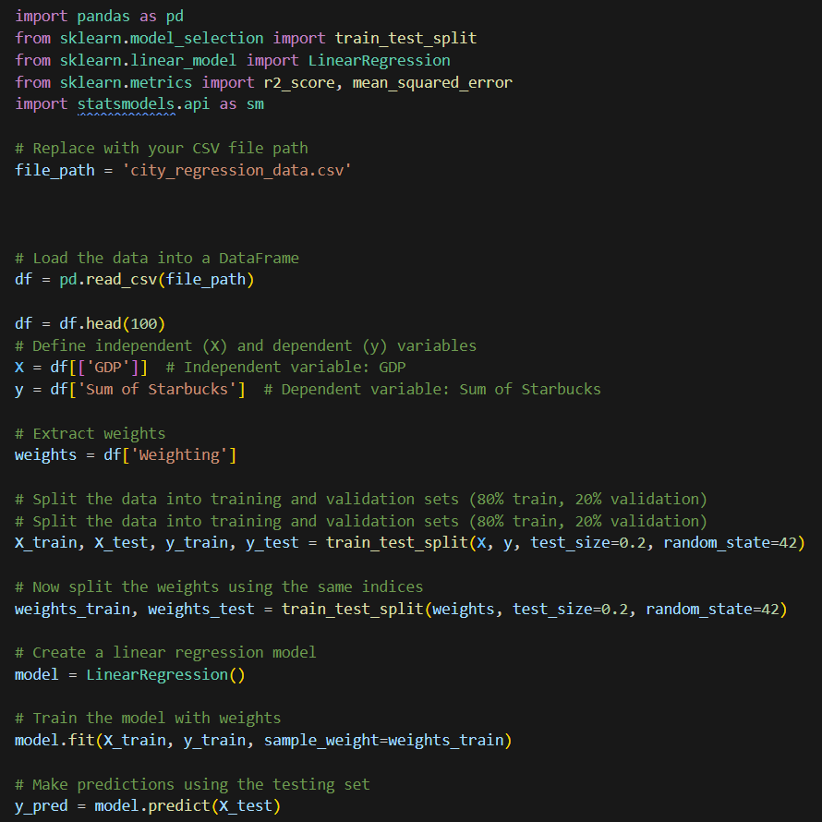
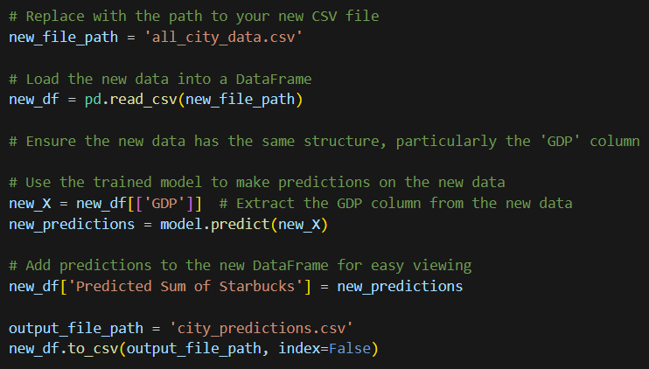
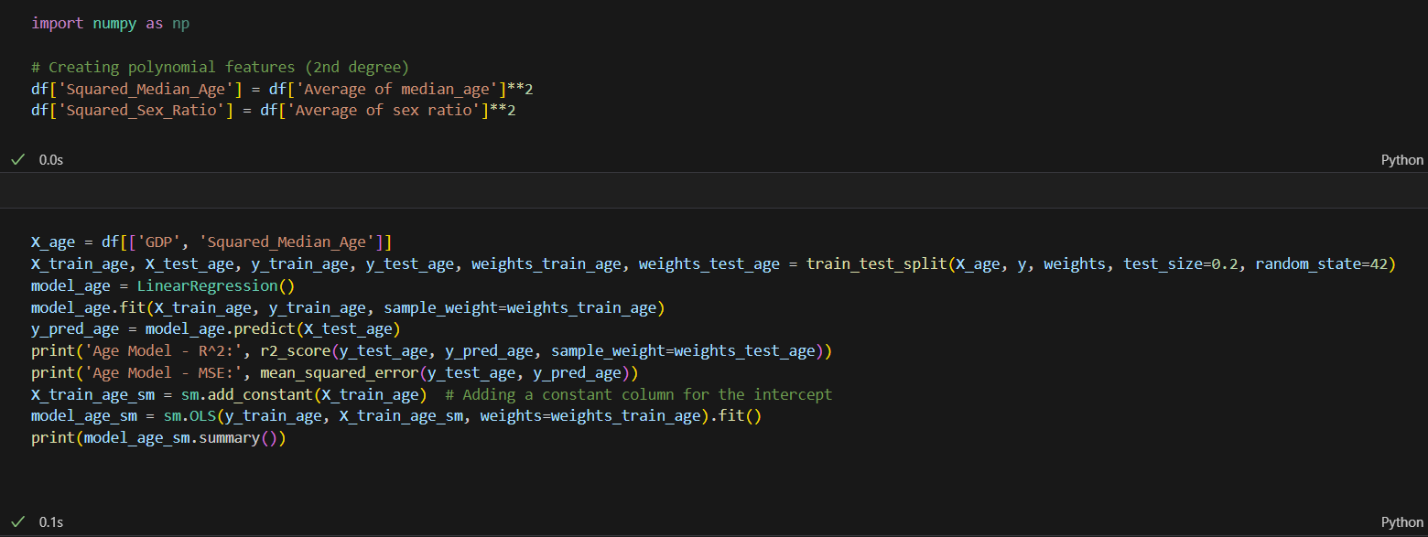
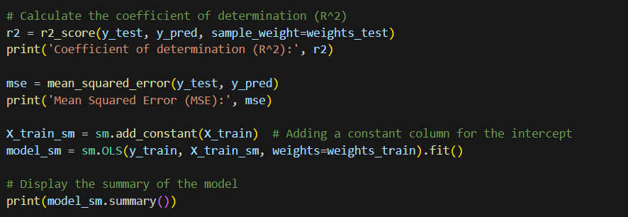
Regression Implementation: Predictive Analytics
Model training and evaluation
Regression
Predictions
Transformation & Regression

Slide 39
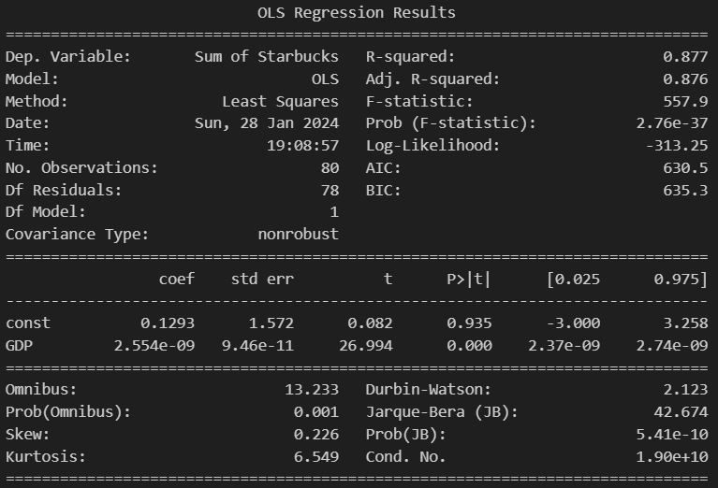
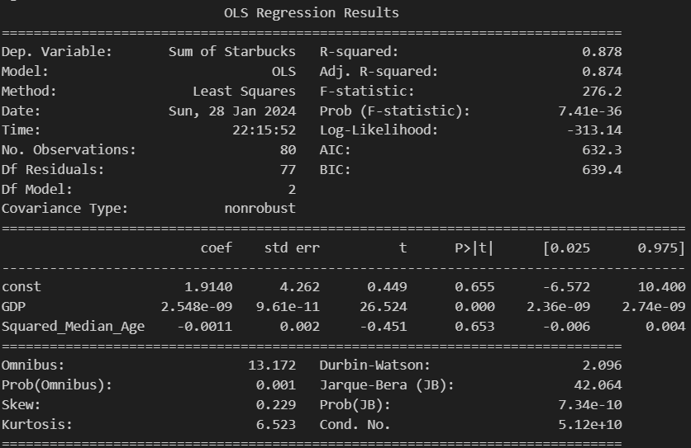
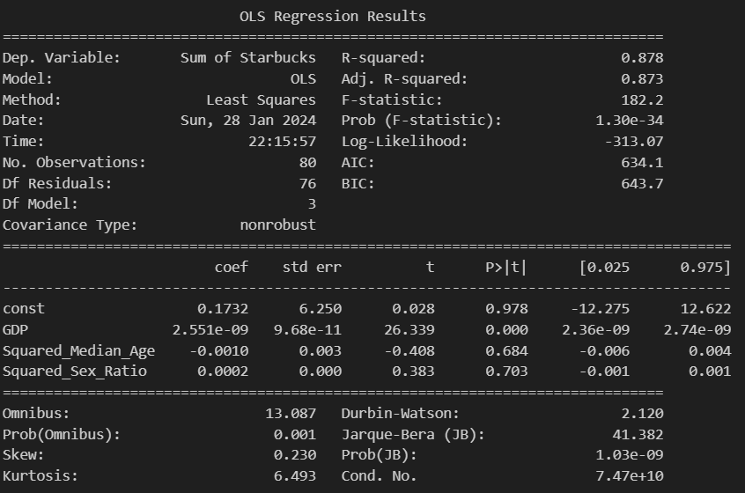
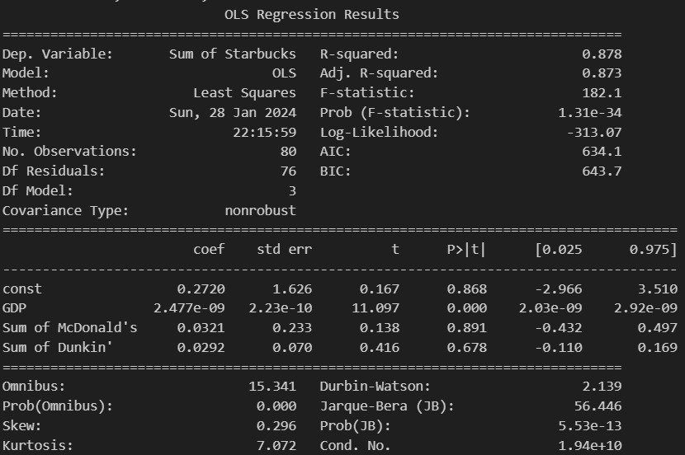
Regression Results
Comparison
Model 1: GDP
Model 2: GDP + Age
Model 3: GDP + Age + Gender
Model 4: GDP + Competitors

Slide 40
Model Selection & Verification
Choosing the optimal regression model
Regression Statistics
R-Squared
0.877
Adjusted R-Squared
0.876
Reasonably high R-Squared
[xxx]
Coefficients
Standard Error
t State
P-Value
Const
0.1293
1.572
0.082
0.935
GDP
2.554e-09
9.46e-11
26.994
0.00
Most simplistic model that has similar R-Squared values, low p-values, and scattered residual plot. This also aligns qualitatively with the idea that GDP is the highest predictor to identifying lucrative opportunities for new locations. Coefficients of other variables are generally low or not statistically significant.

Slide 41
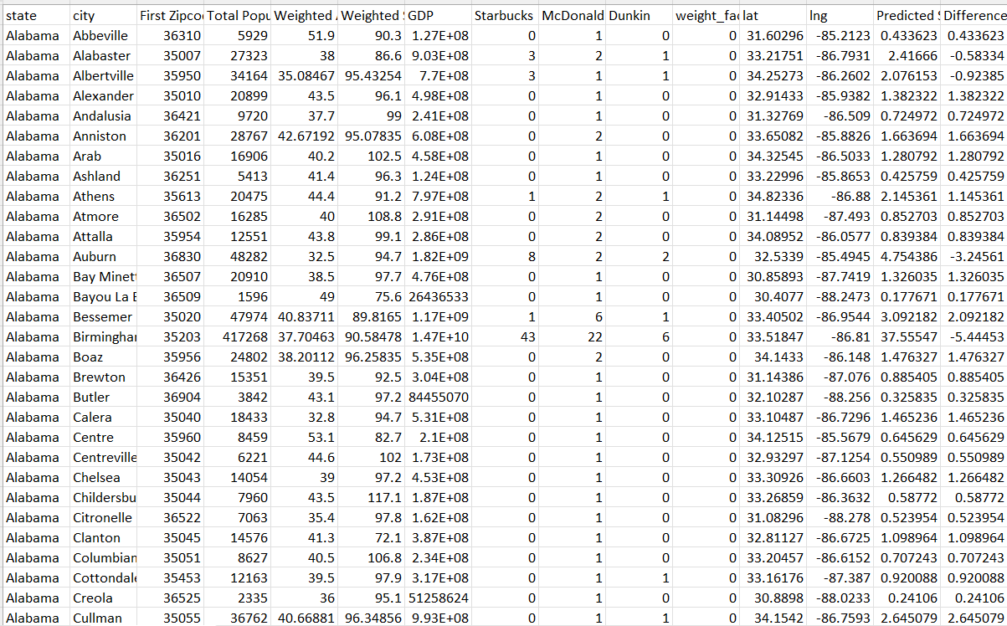
Calculating New Stores
Predicting number of stores for all cities
Calculated Total
7076
…
Howard Shultz wants to open 2000 stores by 2025, the calculated total stores seems reasonable

Slide 42
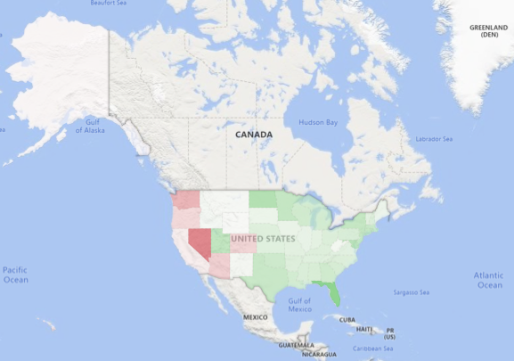
Visualizing Results by State
Current vs. target store differential gradient: [-3/red] to [0/white] to [5/green]

Slide 43
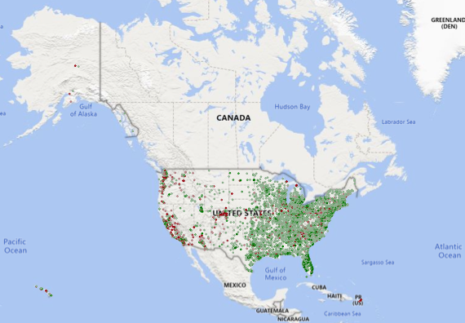
Visualizing Results by Municipal Census Tract
Current vs. target store differential gradient: [-3/red] to [0/white] to [5/green]

Slide 44
Limitations of the Model & Improvement Opportunities
Addressing model constraints and future strategies
Zoning Laws
Store Formats
Rise of Food Delivery
In the US, zoning laws, which vary across counties, specify the percentage of land allocated for commercial use, potentially placing a cap on Starbucks’ expansion.
Starbucks operates standalone and mall stores. The regression model relies on demand and may miss the dynamics within malls: they offer an environment where multiple Starbucks stores can thrive, offering greater accessibility for captured customers.
Services like Starbucks’ mobile app, presents a dual effect. While digital convenience may lessen the need for physical stores, it can also paradoxically stimulate demand for Starbucks, prompting more stores to be established.
Scrape data on the maximum land area for commercial use in each county. Cross-reference this with regression predictions, ensuring the number of additional stores doesn’t exceed the zoning cap.
Scrape data on the quantity of malls and building complexes across the US, using this info to estimate the potential for additional Starbucks stores within these commercial spaces.
Monitor the increasing adoption of food delivery services and evaluate the potential surge in demand for Starbucks; assess the feasibility of opening additional stores to meet the growing demand.
1

Slide 45
Limitations of the Model & Improvement Opportunities – Cont.
Addressing model constraints and future strategies
Data Scrape
Real Estate Trends
Rise of Home Appliance
The regression model relies on the latest scraped data, but factors like seasonal variations, natural disasters, or other events, can distort Starbucks’ store count at the time of scraping, misrepresenting the actual capacity for Starbucks expansion.
Besides zoning laws, there may be a potential shift away from opening standalone shops. Evolving preferences for mixed-use spaces or changes in consumer behavior may challenge the traditional model of Starbucks’ stores.
As remote work becomes more prevalent, the rising popularity of home appliances like coffee machines may reduce the demand for Starbucks stores. This growing trend is not accounted for in the regression, which relies on historical data.
Scrape the latest store count data by location directly from Starbucks’ website and research for any ongoing external events that may have temporarily influenced and misrepresented the store count.
Fetching location-specific real estate prices and forward-looking trends would better help plan the cost associated with building a brick-and-mortar store.
Track the increasing adoption of personal coffee machines and assess any potential impact on Starbucks’ demand, re-running the regression to consider this evolving trend.
1

Slide 46
Limitations of the Model & Improvement Opportunities – Cont.
Addressing model constraints and future strategies
Economic Trends
Location
Our predictions may become outdated as the regression model depends on demographic data, and changes in macroeconomic factors like minimum wage and tax policies can influence consumer demand for coffee and Starbucks stores.
The regression analysis does not consider Starbucks’ historical preference for opening stores in high-traffic areas like street corners, next to parking lots, and near offices.
Regularly monitor evolving federal-level and international policies and events to gauge their impact on demand and the potential for Starbucks to open additional stores.
In addition to collecting zoning regulatory data, assess the availability of preferred high-traffic areas. If these fall short of the space required for predicted additional store openings, evaluate the feasibility of Starbucks opting for new stores in alternative areas.
1

Slide 47
Risks & Mitigations
What are the risks of expanding so aggressively?
Risk Matrix
1
Brand dilution
No capital or supplier constraints so quality should remain high
Strong corporate culture and experience
2
Consumer spending behaviour becomes recessionary
“Soft landing” largely achieved in the USA
Consumer spending expanded more than projected this year
Severity
2
3
Market saturation / cannibalization due to mistaken store openings
Inevitably some stores will be opened that should not have been opened in those locations
Undertake extensive research and lean into learning from mistakes/cutting losses
1
3
Likelihood

Slide 48


Alternative Methodologies and Future Opportunities
Further investigation of other possible approaches
Economic
Geographic (ArcGIS)
Econometric modelling: factor detailed income, employment, spending, and macroeconomic factors into regression model.
Analyze 10k-filings to calculate marginal cost and find the equilibrium point
Spatial analysis: compare current and proposed locations in terms of high foot traffic, nearby amenities, and safety
Demographic decomposition: understand human geographical factors with respect to specific consumer preferences

